Slide 1
AZ-700T00A Module 06: Design and Implement Network Security

Slide 2
Module Overview
Lesson 01: Get network security recommendations with Microsoft Defender for Cloud
Lesson 06: Exercise - Deploy and configure Azure Firewall using the Azure portal
Lesson 02: Deploy Azure DDoS Protection by using the Azure portal
Lesson 07: Working with Azure Firewall Manager
Lesson 03: Exercise - Configure DDoS Protection on a virtual network
Lesson 08: Exercise - Secure your virtual hub using Azure Firewall Manager
Lesson 04: Deploy and configure Network Security Groups
Lesson 09: Implement a Web Application Firewall
Lesson 05: Design and implement Azure Firewall
Notes:
Module overview
Lesson 03: Exercise: Configure DDoS Protection on a virtual network using the Azure portal
Lesson 05: Exercise: Secure your virtual hub using Azure Firewall Manager
Secure and Monitor Networks (15–20%)
Design, implement, and manage an Azure Firewall deployment
• design an Azure Firewall deployment
• create and implement an Azure Firewall deployment
• configure Azure Firewall rules
• create and implement Azure Firewall Manager policies
• create a secure hub by deploying Azure Firewall inside an Azure Virtual WAN hub
• integrate an Azure Virtual WAN hub with a third-party NVA
Implement and manage network security groups (NSGs)
• create an NSG
• associate an NSG to a resource
• create an application security group (ASG)
• associate an ASG to a NIC
• create and configure NSG rules
• interpret NSG flow logs
• validate NSG flow rules
• verify IP flow
Implement a Web Application Firewall (WAF) deployment
• configure detection or prevention mode
• configure rule sets for Azure Front Door, including Microsoft managed and user defined
• configure rule sets for Application Gateway, including Microsoft managed and user defined
• implement a WAF policy
• associate a WAF policy

Slide 3
Lesson 01: Get network security recommendations with Microsoft Defender for Cloud

Slide 4
Secure your virtual networks in the Azure portal overview
Azure Security benchmark
Using Microsoft Defender for Cloud for regulatory compliance
Alerts in Microsoft Defender for Cloud
Network Security
Review

Slide 5
Network Security
NS-1: Establish network segmentation boundaries
NS-2: Secure cloud services with network controls
NS-3: Deploy firewall at the edge of enterprise network
NS-4: Deploy intrusion detection/intrusion prevention systems (IDS/IPS)
NS-5: Deploy DDOS protection
NS-6: Deploy web application firewall
NS-7: Simplify network security configuration
NS-8: Detect and disable insecure services and protocols
NS-9: Connect on-premises or cloud network privately
NS-10: Ensure Domain Name System (DNS) security
Notes:
Network Security covers controls to secure and protect Azure networks, including securing virtual networks, establishing private connections, preventing and mitigating external attacks, and securing DNS. Full description of the controls can be found at:
Azure Security Benchmark v3 - Network Security | Microsoft Docs
https://docs.microsoft.com/security/benchmark/azure/security-controls-v3-network-security

Slide 6
Azure Security benchmark
The Azure Security Benchmark (ASB) provides prescriptive best practices and recommendations to help improve the security of workloads, data, and services on Azure
Term | Description | Example
Control | A control is a high-level description of a feature or activity that needs to be addressed and is not specific to a technology or implementation. | Data Protection is one of the security controls. This control contains specific actions that must be addressed to help ensure data is protected.
Benchmark | A benchmark contains security recommendations for a specific technology, such as Azure. The recommendations are categorized by the control to which they belong. | The Azure Security Benchmark comprises the security recommendations specific to the Azure platform.
Baseline | A baseline is the implementation of the benchmark on the individual Azure service. Each organization decides benchmark recommendation and corresponding configurations are needed in the Azure implementation scope. | The Contoso company looks to enabling Azure SQL security features by following the configuration recommended in Azure SQL security baseline.
Security controls: These recommendations are generally applicable across your Azure tenant and Azure services. Each recommendation identifies a list of stakeholders that are typically involved in planning, approval, or implementation of the benchmark.
Service baselines: These apply the controls to individual Azure services to provide recommendations on that service’s security configuration.
Notes:
The Azure Security Benchmark includes a collection of high-impact security recommendations you can use to help secure the services you use in Azure:
Security controls: These recommendations are generally applicable across your Azure tenant and Azure services. Each recommendation identifies a list of stakeholders that are typically involved in planning, approval, or implementation of the benchmark.
Service baselines: These apply the controls to individual Azure services to provide recommendations on that service’s security configuration.
Implement the Azure Security Benchmark
Plan your Azure Security Benchmark implementation by reviewing the documentation for the enterprise controls and service-specific baselines to plan your control framework and how it maps to guidance like CIS (Controls v7.1) and NIST (SP 800-53) framework.
Monitor your compliance with Azure Security Benchmark status (and other control sets) using the Microsoft Defender for Cloud regulatory compliance dashboard.
Establish guardrails to automate secure configurations and enforce compliance with Azure Security Benchmark (and other requirements in your organization) with Azure Blueprints and Azure Policy.

Slide 7
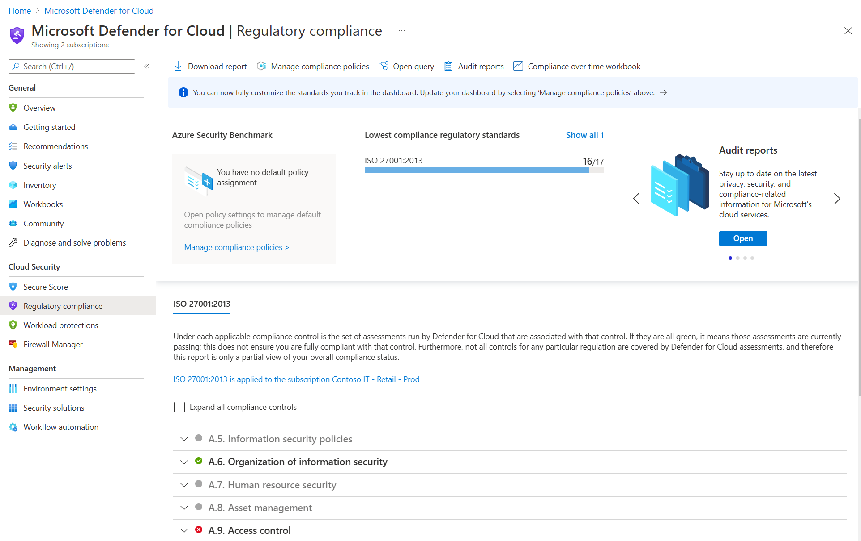
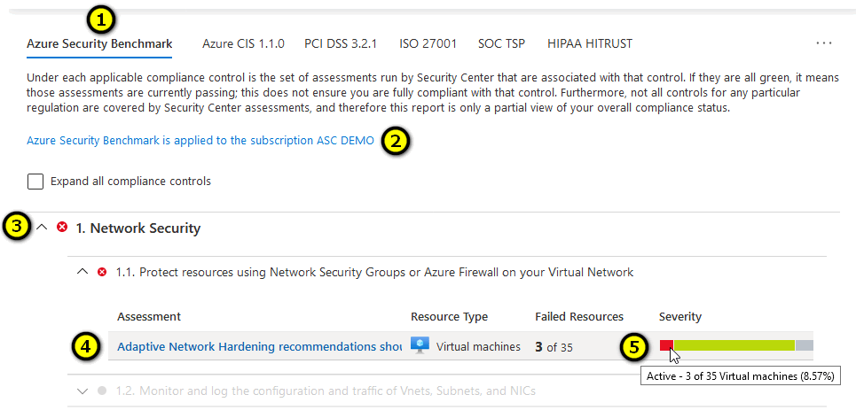
Using Microsoft Defender for Cloud for regulatory compliance
Microsoft Defender for Cloud helps streamline the process for meeting regulatory compliance requirements, using the regulatory compliance dashboard.

Slide 8
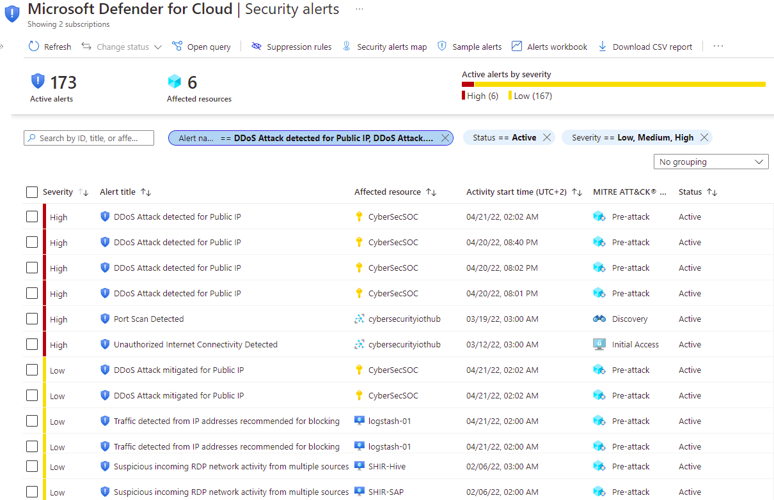
Alerts in Microsoft Defender for Cloud

Slide 9
Summary – Understand the basics of securing your virtual networks
Check your knowledge
Microsoft Learn Modules (docs.microsoft.com/Learn)
Network security concepts and requirements in Azure | Microsoft Docs
Azure network architecture | Microsoft Docs

Slide 10
Lesson 02: Deploy Azure DDoS Protection by using the Azure portal

Slide 11
Deploy Azure DDoS Protection by using the Azure portal overview
Distributed Denial of Service (DDoS)
Azure DDoS protection Standard
Types of DDoS attacks
Azure DDoS protection features
Deploying a DDoS protection plan
Demonstration
Review

Slide 12
Distributed Denial of Service (DDoS)
The goal of a DoS (Denial of Service) attack is to prevent access to services or systems.
Botnets are collections of internet-connected systems that an individual controls and uses without their owners’ knowledge
Bot
Bot
Target
DDoS is a collection of attack types aimed at disrupting the availability of a target
Bot
Bot
DDoS involves many systems sending traffic to targets as part of a botnet
Bot
Notes:
Cloud Provider DDoS attacks - https://www.microsoft.com/securityinsights/DDoS
A denial of service attack (DoS) is an attack that has the goal of preventing access to services or systems. If the attack originates from one location, it is called a DoS. If the attack originates from multiple networks and systems, it is called distributed denial of service (DDoS).
Before learning more about DDoS, you need to know what botnets are. Botnets are collections of internet-connected systems that an individual controls and uses without their owners’ knowledge. Botnet owners use them to perform various actions of their choosing. Often, they use them for spamming, data storage, DDoS, or various other actions that are up to the person in control of the botnet. In the past, botnets were made up just of compromised computers, but now, botnets are also made up of Internet of Things (IoT) devices. Malicious hackers can get these poorly secured security cameras, digital video recorders, thermostats, and other internet-connected devices under their control.
So, DDoS is a collection of attack types aimed at disrupting the availability of a target. These attacks involve a coordinated effort that uses multiple internet-connected systems to launch many network requests against DNS, web services, email, and more. Pretty much any application that the malicious hacker can access might become the target of a DDoS. The malicious hacker’s goal is to overwhelm system resources on targeted servers so they can no longer process legitimate traffic, effectively making the system inaccessible.
A DDoS generally involves many systems sending traffic to targets as part of a botnet. In most cases, the owners of the systems in a botnet don’t know that their devices are compromised and participating in an attack. Botnets are becoming a bigger problem than before because of the increasing numbers of connected devices.

Slide 13
Types of DDoS attacks
Volumetric attacks
These attacks flood the network layer with a substantial amount of seemingly legitimate traffic. They include UDP floods, amplification floods, and other spoofed-packet floods. DDoS Protection Standard mitigates these potential multi-gigabyte attacks by absorbing and scrubbing them, with Azure's global network scale, automatically.
Protocol attacks
These attacks render a target inaccessible, by exploiting a weakness in the layer 3 and layer 4 protocol stack. They include SYN flood attacks, reflection attacks, and other protocol attacks. DDoS Protection Standard mitigates these attacks, differentiating between malicious and legitimate traffic, by interacting with the client, and blocking malicious traffic.
Resource (application) layer attacks
These attacks target web application packets, to disrupt the transmission of data between hosts. They include HTTP protocol violations, SQL injection, cross-site scripting, and other layer 7 attacks. Use a Web Application Firewall, such as the Azure Application Gateway web application firewall, as well as DDoS Protection Standard to provide defense against these attacks. There are also third-party web application firewall offerings available in the Azure Marketplace.

Slide 14
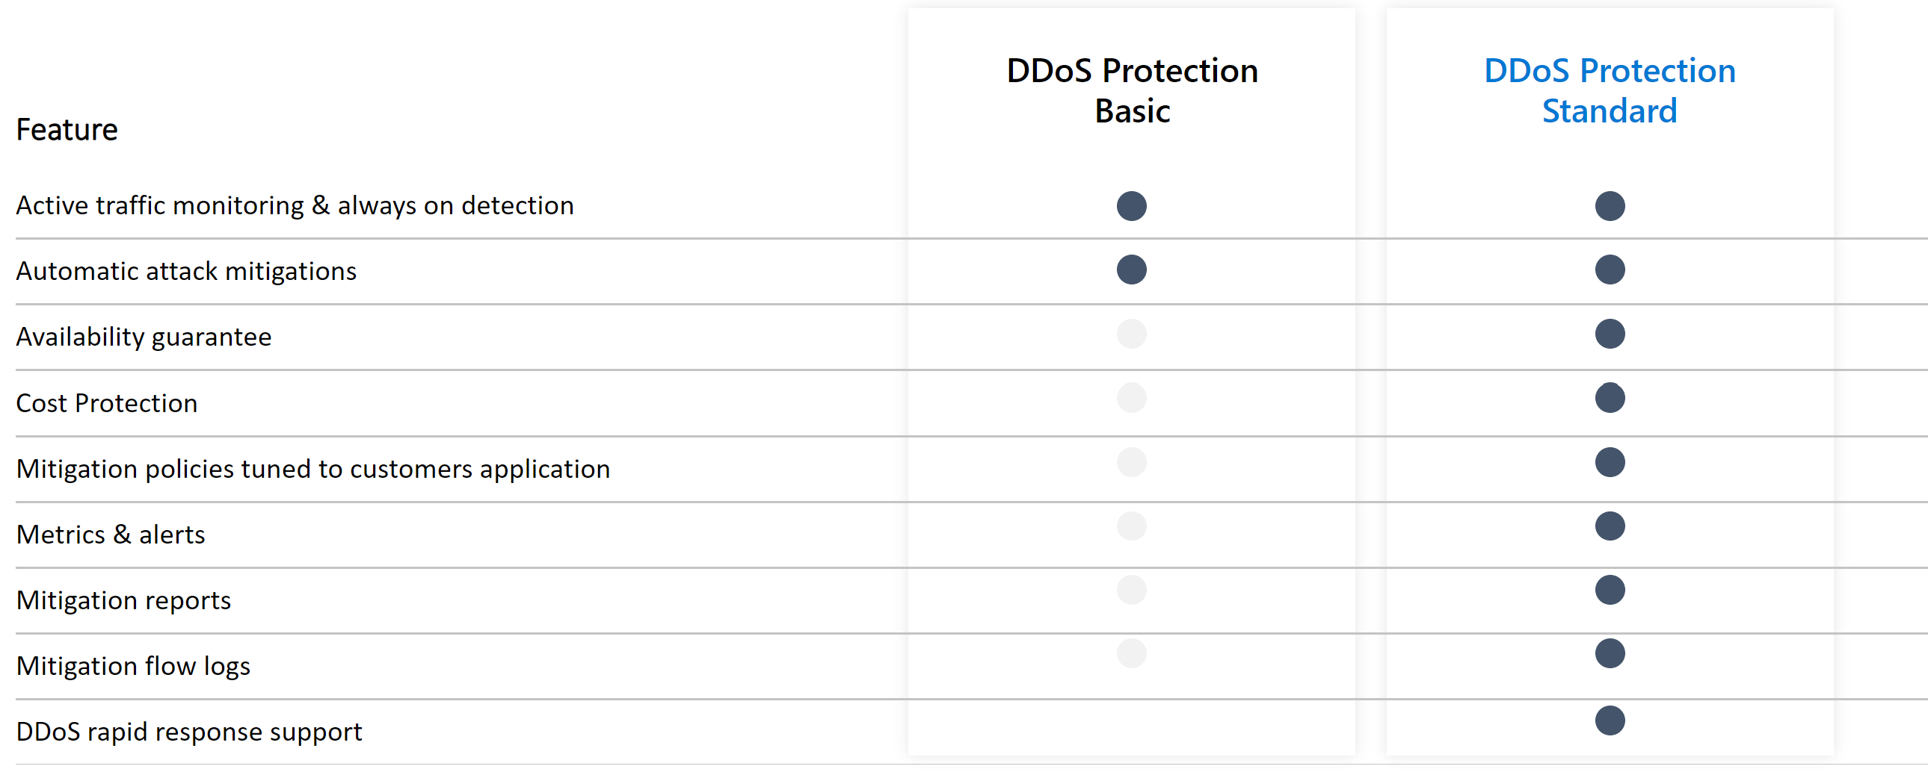
Azure DDoS protection Standard
Notes:
Distributed Denial of Service (DDoS) attacks are some of the largest availability and security concerns facing customers that are moving their applications to the cloud. A DDoS attack tries to drain an API's or application's resources, making that application unavailable to legitimate users. DDoS attacks can be targeted at any endpoint that is publicly reachable through the internet.
Azure DDoS Protection Standard
DDoS Protection Standard protects resources in a virtual network including public IP addresses associated with virtual machines, load balancers, and application gateways. When coupled with the Application Gateway web application firewall, or a third-party web application firewall deployed in a virtual network with a public IP, DDoS Protection Standard can provide full layer 3 to layer 7 mitigation capability.
Every property in Azure is protected by Azure's infrastructure DDoS (Basic) Protection at no additional cost. While DDoS Protection Standard is a paid service, design for services that are deployed in a virtual network.
Native platform integration: Natively integrated into Azure and configured through portal.
Turnkey protection: Simplified configuration protecting all resources immediately.
Always-on traffic monitoring: Your application traffic patterns are monitored 24 hours a day, 7 days a week, looking for indicators of DDoS attacks.
Adaptive tuning: Profiling and adjusting to your service's traffic.
Attack analytics: Get detailed reports in five-minute increments during an attack, and a complete summary after the attack ends.
Attack metrics and alerts: Summarized metrics from each attack are accessible through Azure Monitor. Alerts can be configured at the start and stop of an attack, and over the attack's duration, using built-in attack metrics.
Multi-layered protection: When deployed with a web application firewall (WAF), DDoS Protection Standard protects both at the network layer (Layer 3 and 4, offered by Azure DDoS Protection Standard) and at the application layer (Layer 7, offered by a WAF).

Slide 15
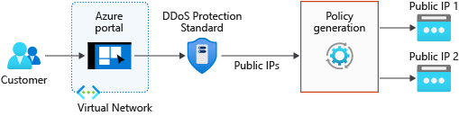
Azure DDoS protection features
Basic and Standard (multiple subscriptions) service tiers
Mitigates volumetric attacks, protocol attacks, and application layer attacks
Checks for malformed packets and spoofing
Notes:
Native platform integration: Natively integrated into Azure and configured through portal.
Turnkey protection: Simplified configuration protecting all resources immediately.
Always-on traffic monitoring: Your application traffic patterns are monitored 24 hours a day, 7 days a week, looking for indicators of DDoS attacks.
Adaptive tuning: Profiling and adjusting to your service's traffic.
Attack analytics: Get detailed reports in five-minute increments during an attack, and a complete summary after the attack ends.
Attack metrics and alerts: Summarized metrics from each attack are accessible through Azure Monitor. Alerts can be configured at the start and stop of an attack, and over the attack's duration, using built-in attack metrics.
Multi-layered protection: When deployed with a web application firewall (WAF), DDoS Protection Standard protects both at the network layer (Layer 3 and 4, offered by Azure DDoS Protection Standard) and at the application layer (Layer 7, offered by a WAF).

Slide 16
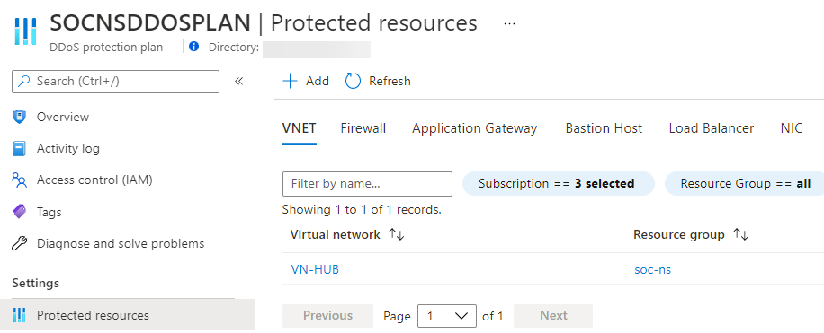
Deploying a DDoS protection plan
Create a DDoS protection plan
Enable DDoS protection on a new or existing VNet
Configure DDoS telemetry
Configure DDoS diagnostic logs and alerts
Run a test DDoS attack and monitor the results
Notes:
Image is end result of protected resource
Select Create a resource in the upper left corner of the Azure portal.
Search the term DDoS. When DDoS protection plan appears in the search results, select it.
Select Create.
Enter or select the following values, then select Create:
SettingValueNameEnter MyDdosProtectionPlan.SubscriptionSelect your subscription.Resource groupSelect Create new and enter MyResourceGroup.LocationEnter East US.
The key stages of deploying as DDoS Protection plan are as follows:
Create a resource group
Create a DDoS Protection Plan
Enable DDoS protection on a new or existing virtual network
Configure DDoS telemetry
Configure DDoS diagnostic logs
Configure DDoS alerts
Run a test DDoS attack and monitor the results

Slide 17
Demonstration - Create and configure Azure DDoS Protection Standard
Create a DDoS protection plan
link it to a virtual network
Notes:
Demo creating a DDoS protection plan
**PRICE** its expensive watch out
Manage Azure DDoS Protection Standard using the Azure portal | Microsoft Docs

Slide 18
Summary – Deploy Azure DDoS Protection by using the Azure portal
Check your knowledge
Microsoft Learn Modules (docs.microsoft.com/Learn)
Azure DDoS Protection Standard documentation | Microsoft Docs
Manage Azure DDoS Protection Standard using the Azure portal | Microsoft Docs

Slide 19
Lesson 03: Exercise: Configure DDoS Protection on a virtual network using the Azure portal

Slide 20
Exercise: Configure DDoS Protection on a virtual network using the Azure portal
Task 1: Create a resource group
Task 2: Create a DDoS Protection plan
Task 3: Enable DDoS Protection on a new virtual network
Task 4: Configure DDoS telemetry
Task 5: Configure DDoS diagnostic logs
Task 6: Configure DDoS alerts
Task 7: Submit a DDoS service request to run a DDoS attack
Notes:
Task 1: Create a resource group
Task 2: Create a DDoS Protection plan
Task 3: Enable DDoS Protection on a new virtual network
Task 4: Configure DDoS telemetry
Task 5: Configure DDoS diagnostic logs
Task 6: Configure DDoS alerts
Task 7: Submit a DDoS service request to run a DDoS attack

Slide 21
Summary –Exercise: Configure DDoS Protection on a virtual network using the Azure portal
Check your knowledge
Microsoft Learn Modules (docs.microsoft.com/Learn)
Azure DDoS Protection Standard documentation | Microsoft Docs

Slide 22
Lesson 04: Deploy and configure Network Security Groups

Slide 23
Deploy and configure Network Security Groups overview
Network Security Groups
Use Service Tags to define network access controls
Default NSG Rules
Application Security Groups
NSG Effective Rules
Demonstration
Creating NSG rules
Review

Slide 24
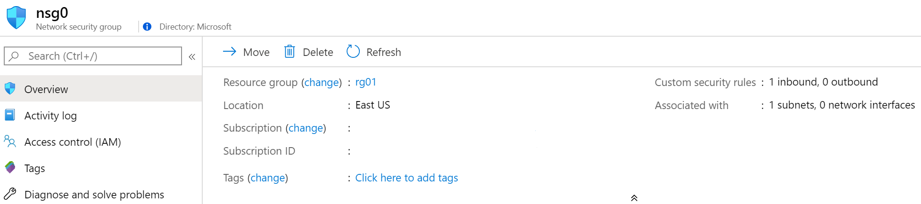
Network Security Groups
Limits network traffic to resources in a virtual network
Lists the security rules that allow or deny inbound or outbound network traffic
Associated to a subnet or a network interface
Can be associated multiple times
Notes:
Network Security Groups - https://docs.microsoft.com/en-us/azure/virtual-network/security-overview#network-security-groups
✔️ To simplify management of security rules, it's recommended that you associate a network security group to individual subnets, rather than individual network interfaces within the subnet.

Slide 25
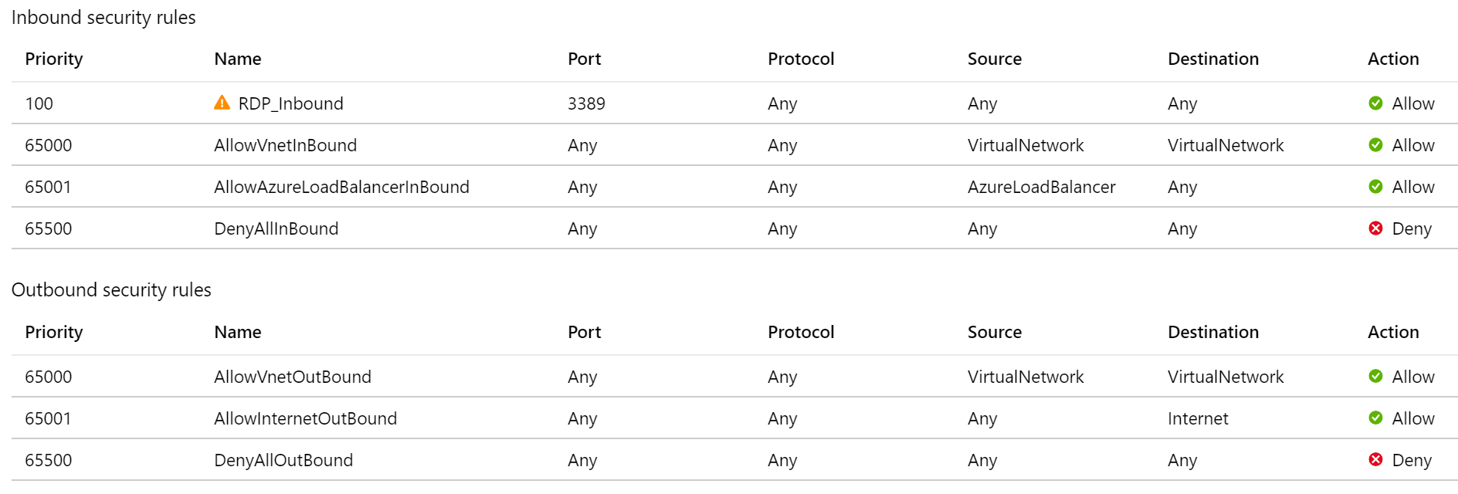
NSG Rules
Security rules in NSGs enable you to filter network traffic that can flow in and out of virtual network subnets and network interfaces
There are default security rules. You cannot delete the default rules, but you can add other rules with a higher priority
Notes:
Create, change, or delete a network security group -https://docs.microsoft.com/en-us/azure/virtual-network/manage-network-security-group
A network security group contains zero, or as many rules as desired, within Azure subscription limits. Each rule specifies the following properties:
Name - Must be a unique name within the network security group.
Priority - Can be any number between 100 and 4096. Rules are processed in priority order, with lower numbers processed before higher numbers, because lower numbers have higher priority. Once traffic matches a rule, processing stops. As a result, any rules that exist with lower priorities (higher numbers) that have the same attributes as rules with higher priorities are not processed.
Source or destination - Can be set to Any, or an individual IP address, or classless inter-domain routing (CIDR) block (10.0.0.0/24, for example), service tag, or application security group.
Protocol - Can be TCP, UDP, ICMP, ESP, AH, or Any.
Direction - Can be configured to apply to inbound, or outbound traffic.
Port range - Can be specified either as an individual port or range of ports. For example, you could specify 80 or 10000-10005. Specifying ranges enables you to create fewer security rules.
Action - Can be set to Allow or deny.

Slide 26
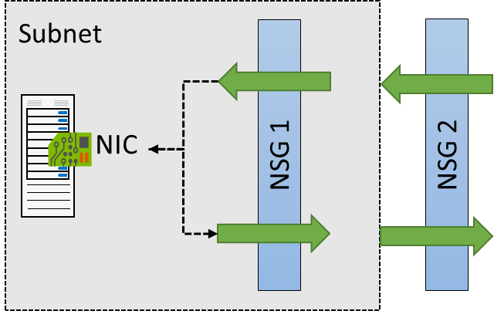
NSG Effective Rules
NSGs are evaluated independently for the subnet and NIC
An “allow” rule must exist at both levels for traffic to be admitted
Use the Effective Rules link if you are not sure which security rules are being applied

Slide 27
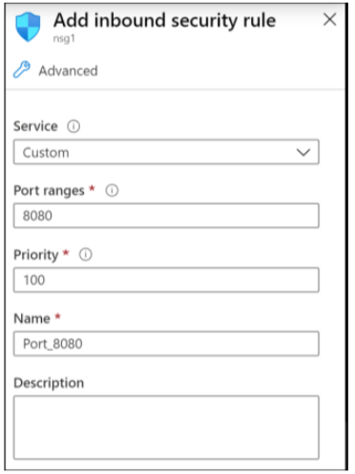
Creating NSG rules
Select from a large variety of services
Service – The destination protocol and port range for this rule
Port ranges – Single port or multiple ports
Priority – The lower the number, the higher the priority
Notes:
Tutorial: Filter network traffic with a network security group using the Azure portal - https://docs.microsoft.com/en-us/azure/virtual-network/tutorial-filter-network-traffic
Secure and isolate access to Azure resources by using network security groups and service endpoints - https://docs.microsoft.com/learn/modules/secure-and-isolate-with-nsg-and-service-endpoints/

Slide 28
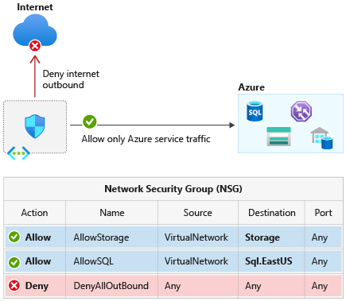
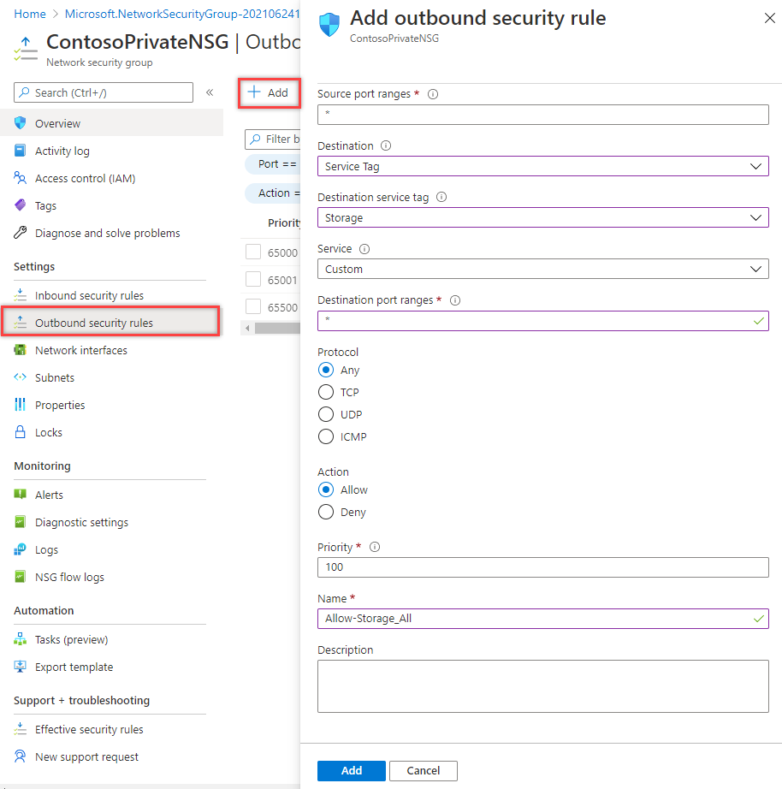
Use Service Tags to define network access controls
Notes:
A service tag represents a group of IP address prefixes from a given Azure service. Microsoft manages the address prefixes encompassed by the service tag and automatically updates the service tag as addresses change, minimizing the complexity of frequent updates to network security rules.
You can use service tags to define network access controls on network security groups or Azure Firewall. Use service tags in place of specific IP addresses when you create security rules. By specifying the service tag name, such as API Management, in the appropriate source or destination field of a rule, you can allow or deny the traffic for the corresponding service.
As of March 2021, you can also use Service Tags in place of explicit IP ranges in user defined routes. This feature is currently in Public Preview.
You can use service tags to achieve network isolation and protect your Azure resources from the general Internet while accessing Azure services that have public endpoints. Create inbound/outbound network security group rules to deny traffic to/from Internet and allow traffic to/from AzureCloud or other available service tags of specific Azure services.

Slide 29
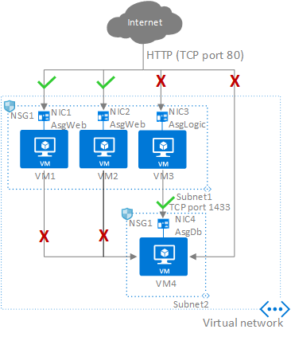
Application Security Groups (ASG)
Configure ASG as a natural extension of an application's structure
ASG can be the source and destination in a security rule
All NIC assigned to an ASG must exist in the same virtual network that the first NIC assigned to the ASG is in
If you specify an ASG as the source and destination in a security rule, the NIC in both ASG must exist in the same virtual network
Notes:
An Application Security Group (ASG) enables you to configure network security as a natural extension of an application's structure, allowing you to group virtual machines and define network security policies based on those groups. You can reuse your security policy at scale without manual maintenance of explicit IP addresses. The platform handles the complexity of explicit IP addresses and multiple rule sets, allowing you to focus on your business logic.
To minimize the number of security rules you need, and the need to change the rules, plan out the application security groups you need and create rules using service tags or application security groups, rather than individual IP addresses, or ranges of IP addresses, whenever possible.
Application security groups have the following constraints:
There are limits to the number of application security groups you can have in a subscription, as well as other limits related to application security groups. For details, see Azure limits.
In the Azure portal, you can specify only one application security group as the source and destination in a security rule. In the REST API (including PowerShell/Azure CLI), you can specify multiple application security groups in the source or destination.
All network interfaces assigned to an application security group have to exist in the same virtual network that the first network interface assigned to the application security group is in. For example, if the first network interface assigned to an application security group named AsgWeb is in the virtual network named VNet1, then all subsequent network interfaces assigned to ASGWeb must exist in VNet1. You cannot add network interfaces from different virtual networks to the same application security group.
If you specify an application security group as the source and destination in a security rule, the network interfaces in both application security groups must exist in the same virtual network. For example, if AsgLogic contained network interfaces from VNet1, and AsgDb contained network interfaces from VNet2, you could not assign AsgLogic as the source and AsgDb as the destination in a rule. All network interfaces for both the source and destination application security groups need to exist in the same virtual network.

Slide 30
Demonstration – Network Security Rules
Access the NSGs blade
Add a new NSG
Explore inbound and outbound rules
Notes:
Always consider having students walk-through the demonstrations themselves. Also, consider the overlap with the formal labs and your best use of time.

Slide 31
Deploy and configure Network Security Groups - Review
Knowledge Check
Microsoft Learn Modules (docs.microsoft.com/Learn)
Azure network security groups overview | Microsoft Docs
Azure application security groups overview | Microsoft Docs
Notes:
Learn - https://docs.microsoft.com/en-us/learn/browse/

Slide 32
Lesson 05: Design and implement Azure Firewall
Notes:
Design, implement, and manage an Azure Firewall deployment
• design an Azure Firewall deployment
• create and implement an Azure Firewall deployment
• configure Azure Firewall rules
• create and implement Azure Firewall Manager policies
• create a secure hub by deploying Azure Firewall inside an Azure Virtual WAN hub
• integrate an Azure Virtual WAN hub with a third-party NVA

Slide 33
Design and implement Azure Firewall overview
Azure Firewall features
Rule processing in Azure Firewall
Deploying Azure Firewall in the Azure portal
Deploying Azure Firewall in a Hub-Spoke network topology
Compare Azure Firewall to NSGs
Review

Slide 34
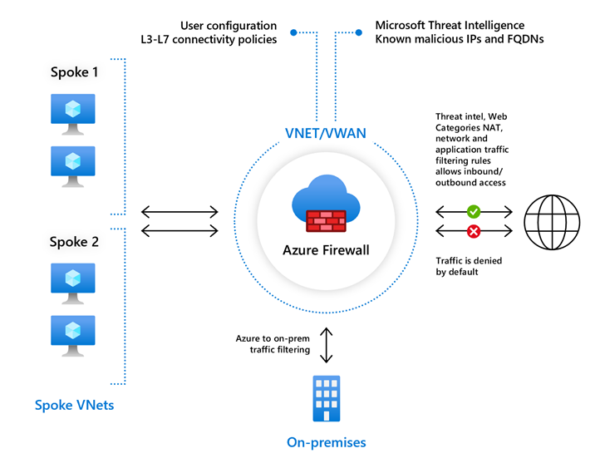
Azure Firewall features
Stateful firewall as a service
Built-in high availability with unrestricted cloud scalability
Create, enforce, and log application and network connectivity policies
Threat intelligence-based filtering for L3-L7
Fully integrated with Azure Monitor for logging and analytics
Support for hybrid connectivity through deployment behind VPN and ExpressRoute Gateways
Standard and Premium SKUs
Notes:
Azure Firewall documentation - https://docs.microsoft.com/en-us/azure/firewall/
Standard and Premium SKUs
Compare NSG and Firewall

Slide 35
Rule processing in Azure Firewall
NAT rules. Configure DNAT rules to allow incoming connections
Network rules. Configure rules that contain source addresses, protocols, destination ports, and destination addresses
Application rules. Configure fully qualified domain names (FQDNs) that can be accessed from a subnet
Notes:
In the Azure Firewall, you can configure NAT rules, network rules, and applications rules, and this can be done either by using classic rules or Firewall Policy. An Azure Firewall denies all traffic by default, until rules are manually configured to allow traffic.
With Firewall Policy, rules are organized inside Rule Collections which are contained in Rule Collection Groups. Rule Collections can be of the following types:
DNAT (Destination Network Address Translation)
Network
Application
You can define multiple Rule Collection types within a single Rule Collection Group, and you can define zero or more Rules in a Rule Collection, but the rules within a Rule Collection must be of the same type (i.e., DNAT, Network, or Application).

Slide 36
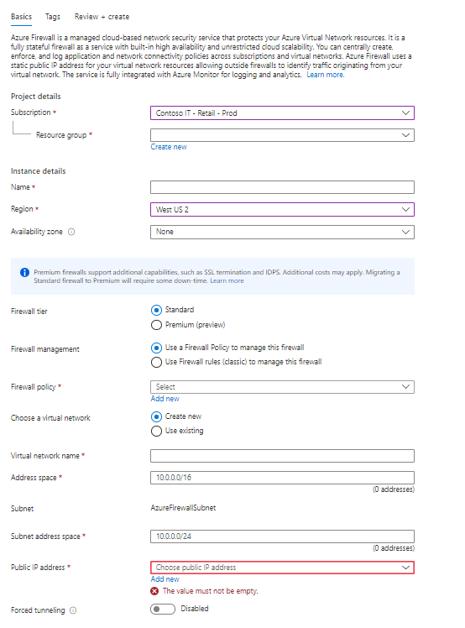
Deploying Azure Firewall in the Azure portal
On the Create a Firewall page enter the following:
Subscription
Resource Group
Instance Name, region and Availability Zone if any
Firewall tier
Firewall management
Firewall Policy
Choose a virtual network
Forced tunneling
Notes:
Azure Firewall Subnet must exist already ( you can't on the fly create the AzureFirewallSubnet )
Hub-spoke network topology in Azure - https://docs.microsoft.com/en-us/azure/architecture/reference-architectures/hybrid-networking/hub-spoke
The key stages of deploying and configuring Azure Firewall are as follows:
Create a resource group
Create a virtual network and subnets
Create a workload VM in a subnet
Deploy the firewall and policy to the virtual network
Create a default outbound route
Configure an application rule
Configure a network rule
Configure a Destination NAT (DNAT) rule
Test the firewall
One of the major features of Azure Firewall is Availability Zones.
When deploying Azure Firewall, you can configure it to span multiple Availability Zones for increased availability. When you configure Azure Firewall in this way your availability increases to 99.99% uptime. The 99.99% uptime SLA is offered when two or more Availability Zones are selected.
You can also associate Azure Firewall to a specific zone just for proximity reasons, using the service standard 99.95% SLA.
For more information, see the Azure Firewall Service Level Agreement (SLA).
There's no additional cost for a firewall deployed in an Availability Zone. However, there are added costs for inbound and outbound data transfers associated with Availability Zones.
For more information, see Bandwidth pricing details.
Azure Firewall Availability Zones are only available in regions that support Availability Zones.
Availability Zones can only be configured during firewall deployment. You cannot configure an existing firewall to include Availability Zones.

Slide 37
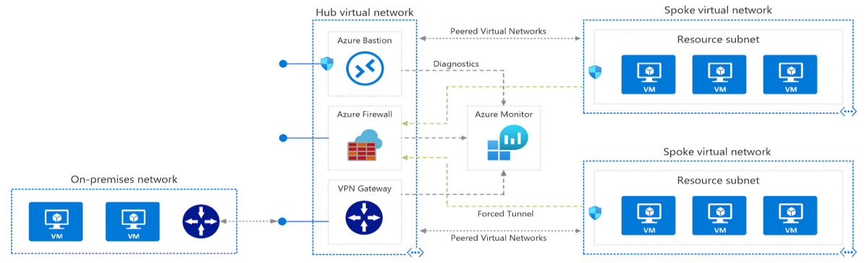
Deploying Azure Firewall in a Hub-Spoke network topology
A Hub-Spoke network topology is recommended
Shared services are placed in the hub virtual network
Each environment is deployed to a spoke to maintain isolation
Notes:
Hub-spoke network topology in Azure - https://docs.microsoft.com/en-us/azure/architecture/reference-architectures/hybrid-networking/hub-spoke
High level overview of Azure bastion: Azure Bastion is a service you deploy that lets you connect to a virtual machine using your browser and the Azure portal. The Azure Bastion service is a fully platform-managed PaaS service that you provision inside your virtual network. It provides secure and seamless RDP/SSH connectivity to your virtual machines directly from the Azure portal over TLS. When you connect via Azure Bastion, your virtual machines do not need a public IP address, agent, or special client software.
The key stages of deploying and configuring Azure Firewall are as follows:
Create a resource group
Create a virtual network and subnets
Create a workload VM in a subnet
Deploy the firewall and policy to the virtual network
Create a default outbound route
Configure an application rule
Configure a network rule
Configure a Destination NAT (DNAT) rule
Test the firewall
One of the major features of Azure Firewall is Availability Zones.
When deploying Azure Firewall, you can configure it to span multiple Availability Zones for increased availability. When you configure Azure Firewall in this way your availability increases to 99.99% uptime. The 99.99% uptime SLA is offered when two or more Availability Zones are selected.
You can also associate Azure Firewall to a specific zone just for proximity reasons, using the service standard 99.95% SLA.
For more information, see the Azure Firewall Service Level Agreement (SLA).
There's no additional cost for a firewall deployed in an Availability Zone. However, there are added costs for inbound and outbound data transfers associated with Availability Zones.
For more information, see Bandwidth pricing details.
Azure Firewall Availability Zones are only available in regions that support Availability Zones.
Availability Zones can only be configured during firewall deployment. You cannot configure an existing firewall to include Availability Zones.

Slide 38
Compare Azure Firewall to NSGs
 | NSG | Azure Firewall
Protocol based traffic filtering | Yes | Yes
Support Service Tags | Yes | Yes
Support Application FQDN Tags | No | Yes
Integrated with Azure Monitor for diagnostic logging | Yes | Yes
SNAT and DNAT support | No | Yes
Notes:
Azure Firewall FAQ | Microsoft Docs
The Azure Firewall service complements network security group functionality. Together, they provide better "defense-in-depth" network security. Network security groups provide distributed network layer traffic filtering to limit traffic to resources within virtual networks in each subscription. Azure Firewall is a fully stateful, centralized network firewall as-a-service, which provides network- and application-level protection across different subscriptions and virtual networks.

Slide 39
Summary – Design and implement Azure Firewall
Check your knowledge
Microsoft Learn Modules (docs.microsoft.com/Learn)
What is Azure Firewall? | Microsoft Docs
Azure Firewall features | Microsoft Docs

Slide 40
Lesson 06: Exercise - Deploy and configure Azure Firewall using the Azure portal

Slide 41

Exercise - Deploy and configure Azure Firewall using the Azure portal
Task 1: Create a resource group
Task 2: Create a virtual network and subnets
Task 3: Create a virtual machine
Task 4: Deploy the firewall and firewall policy
Task 5: Create a default route
Task 6: Configure an application rule
Task 7: Configure a network rule
Task 8: Configure a Destination NAT (DNAT) rule
Task 9: Change the primary and secondary DNS address for the server's network interface
Task 10: Test the firewall
Task 11: Clean up resources

Slide 42
Review – Deploy and configure Azure Firewall using the Azure portal
Check your knowledge
Microsoft Learn Modules (docs.microsoft.com/Learn)
QuickStart: Create an Azure Firewall and IP Groups - Resource Manager template
Notes:
Quickstart: Create an Azure Firewall and IP Groups - Resource Manager template | Microsoft Docs
https://docs.microsoft.com/azure/firewall/quick-create-ipgroup-template

Slide 43
Lesson 07: Working with Azure Firewall Manager

Slide 44
Working with Azure Firewall Manager overview
Azure Firewall Manager features
Azure Firewall Manager policies
Azure Firewall Manager for Hub Virtual Networks vs Secured Virtual Hubs
Using Azure Firewall Manager
Demonstration
Review

Slide 45
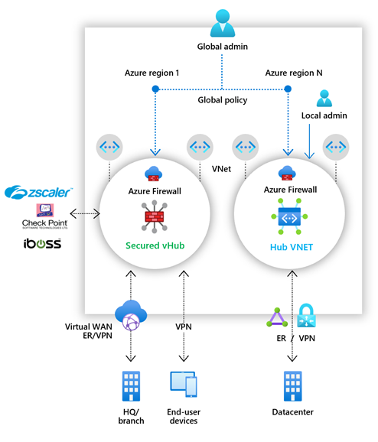
Azure Firewall Manager features
Central Azure Firewall deployment and configuration
Hierarchical policies (global and local)
Integrated with third-party security-as-a-service for advanced security
Centralized route management
Region availability
Notes:
Azure Firewall Manager is a security management service that provides central security policy and route management for cloud-based security perimeters.
Firewall Manager can provide security management for two network architecture types:
Secured virtual hub
An Azure Virtual WAN Hub is a Microsoft-managed resource that lets you easily create hub and spoke architectures. When security and routing policies are associated with such a hub, it is referred to as a secured virtual hub.
Hub virtual network
This is a standard Azure virtual network that you create and manage yourself. When security policies are associated with such a hub, it is referred to as a hub virtual network. At this time, only Azure Firewall Policy is supported. You can peer spoke virtual networks that contain your workload servers and services. You can also manage firewalls in standalone virtual networks that aren't peered to any spoke.

Slide 46
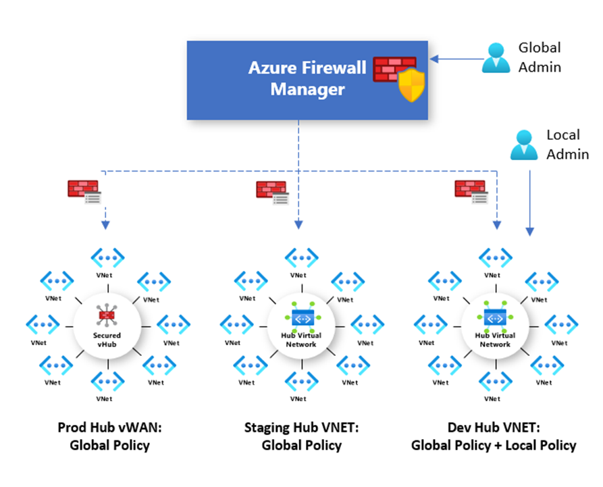
Azure Firewall Manager policies
A policy can be created and managed in multiple ways, including the Azure portal, REST API, templates, Azure PowerShell, and CLI.
Policies can be associated with one or more virtual hubs or VNets. The firewall can be in any subscription associated with your account and in any region.
Notes:
A policy can be created and managed in multiple ways, including the Azure portal, REST API, templates, Azure PowerShell, and CLI.
You can also migrate existing rules from Azure Firewall using the portal or Azure PowerShell to create policies. For more information, see How to migrate Azure Firewall configurations to Azure Firewall policy.
Policies can be associated with one or more virtual hubs or VNets. The firewall can be in any subscription associated with your account and in any region.

Slide 47
Azure Firewall Manager for Hub Virtual Networks vs Secured Virtual Hubs
 | Hub virtual network | Secured virtual hub
Underlying resource | Virtual network | Virtual WAN Hub
Hub & Spoke | Uses Virtual network peering | Automated using hub virtual network connection
On-prem connectivity | VPN Gateway up to 10 Gbps and 30 S2S connections; ExpressRoute | More scalable VPN Gateway up 20 Gbps and 1000 S2S connections; Express Route
Automated branch connectivity using SDWAN | Not supported | Supported
Hubs per region | Multiple Virtual Networks per region | Single Virtual Hub per region. Multiple hubs possible with multiple Virtual WANs
Azure Firewall – multiple public IP addresses | Customer provided | Auto generated
Notes:
Hub virtual network: What are the Azure Firewall Manager architecture options? | Microsoft Docs
This is a standard Azure virtual network that you create and manage yourself. When security policies are associated with such a hub, it is referred to as a hub virtual network. At this time, only Azure Firewall Policy is supported. You can peer spoke virtual networks that contain your workload servers and services. You can also manage firewalls in standalone virtual networks that aren't peered to any spoke.

Slide 48
Azure Firewall Manager for Hub Virtual Networks vs Secured Virtual Hubs part 2
 | Hub virtual network | Secured virtual hub
Azure Firewall Availability Zones | Supported | Not yet available
Advanced Internet security with third-party Security as a Service partners | Customer established and managed VPN connectivity to partner service of choice | Automated via security partner provider flow and partner management experience
Centralized route management to route traffic to the hub | Customer-managed User Defined Route | Supported using BGP
Multiple security provider support | Supported with manually configured forced tunneling to third-party firewalls | Automated support for two security providers: Azure Firewall for private traffic filtering and third party for Internet filtering
Web Application Firewall on Application Gateway | Supported in Virtual Network | Currently supported in spoke network
Network Virtual Appliance | Supported in Virtual Network | Currently supported in spoke network
Azure DDoS Protection Standard support | Yes | No
Notes:
Hub virtual network: What are the Azure Firewall Manager architecture options? | Microsoft Docs
This is a standard Azure virtual network that you create and manage yourself. When security policies are associated with such a hub, it is referred to as a hub virtual network. At this time, only Azure Firewall Policy is supported. You can peer spoke virtual networks that contain your workload servers and services. You can also manage firewalls in standalone virtual networks that aren't peered to any spoke.
Design, implement, and manage an Azure Firewall deployment

Slide 49
Deploying Azure Firewall Manager
Hub virtual networks
Create a firewall policy
Create your hub and spoke architecture
Select security providers and associate firewall policy. Currently, only Azure Firewall is a supported provider.
Configure User Define Routes to route traffic to your Hub Virtual Network firewall.
Secured virtual WAN hubs
Create your hub and spoke architecture
Select security providers
Create a firewall policy and associate it with your hub
Configure route settings to route traffic to your secured hub
Notes:
There's more than one way to deploy Azure Firewall Manager, but the following general process is recommended.

Slide 50
Demonstration
Create a firewall policy
Peer the hub and spoke virtual networks
Create the virtual networks
Create the routes
Configure and deploy the firewall
Create the virtual machines
Create and connect the VPN gateways
Test the firewall
Notes:
Based on previous exercise ( hub and spoke ) you can demo azure firewall manager
Tutorial: Secure your hub virtual network using Azure Firewall Manager | Microsoft Docs

Slide 51
Review – Secure your networks with Azure Firewall Manager
Check your knowledge
Microsoft Learn Modules (docs.microsoft.com/Learn)
What is Azure Firewall Manager? | Microsoft Docs
Notes:
Learn - https://docs.microsoft.com/en-us/learn/browse/
Plan and manage your Azure costs - https://docs.microsoft.com/en-us/learn/modules/plan-manage-azure-costs/
Analyze costs and create budgets with Azure Cost Management - https://docs.microsoft.com/en-us/learn/modules/analyze-costs-create-budgets-azure-cost-management/
References

Slide 52
Lesson 08: Exercise- Secure your virtual hub using Azure Firewall Manager

Slide 53

Exercise- Secure your virtual hub using Azure Firewall Manager
Task 1: Create two spoke virtual networks and subnets
Task 2: Create the secured virtual hub
Task 3: Connect the hub and spoke virtual networks
Task 4: Deploy the servers
Task 5: Create a firewall policy and secure your hub
Task 6: Associate the firewall policy
Task 7: Route traffic to your hub
Task 8: Test the application rule
Task 9: Test the network rule
Task 10: Clean up resources
Notes:
Task 1: Create two spoke virtual networks and subnets
Task 2: Create the secured virtual hub
Task 3: Connect the hub and spoke virtual networks
Task 4: Deploy the servers
Task 5: Create a firewall policy and secure your hub
Task 6: Associate the firewall policy
Task 7: Route traffic to your hub
Task 8: Test the application rule
Task 9: Test the network rule
Task 10: Clean up resources

Slide 54
Review – Exercise: Deploy and configure Azure Firewall
Check your knowledge
Microsoft Learn Modules (docs.microsoft.com/Learn)
Tutorial: Secure your virtual hub using Azure Firewall Manager | Microsoft Docs

Slide 55
Lesson 09: Implement a Web Application Firewall

Slide 56
Implement a Web Application Firewall overview
Web Application Firewall overview
Web Application Firewall policy modes
Web Application Firewall Default Rule Set, rule groups, and rules
Web Application Firewall Custom Rules
Create a Web Application Firewall policy on Azure Front Door
Review

Slide 57
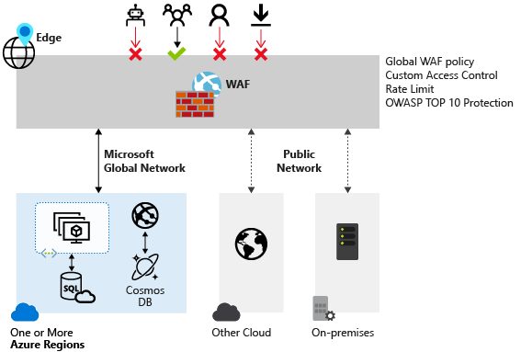
Web Application Firewall overview
Provides centralized protection of your web applications from common exploits and vulnerabilities
A centralized web application firewall helps make security management much simpler
A WAF also gives application administrators better assurance of protection against threats and intrusions
A WAF solution can react to a security threat faster by centrally patching a known vulnerability, instead of securing each individual web application
Notes:
Web Application Firewall (WAF) provides centralized protection of your web applications from common exploits and vulnerabilities. Web applications are increasingly targeted by malicious attacks that exploit commonly known vulnerabilities. SQL injection and cross-site scripting are among the most comm
Preventing such attacks in application code is challenging. It can require rigorous maintenance, patching, and monitoring at multiple layers of the application topology. A centralized web application firewall helps make security management much simpler. A WAF also gives application administrators better assurance of protection against threats and intrusions.
A WAF solution can react to a security threat faster by centrally patching a known vulnerability, instead of securing each individual web application.
Supported service
WAF can be deployed with Azure Application Gateway and Azure Front Door. WAF on Azure CDN is currently under public preview. WAF has features that are customized for each specific service.

Slide 58
Web Application Firewall with Azure services
WAF on Azure Application Gateway
WAF on Azure Front Door
You can create multiple policies, and they can be associated with an Application Gateway, to individual listeners, or to path-based routing rules on an Application Gateway
Customizable and separate policies for each site behind your Application Gateway if needed
Monitor attacks
Global and centralized solution
WAF enabled web applications inspect every incoming request delivered by Front Door at the network edge
WAF policy can be associated to one or more Front Door front-ends for protection
Notes:
Protection
Monitoring
Customization
What is Azure Web Application Firewall on Azure Application Gateway?
https://docs.microsoft.com/azure/web-application-firewall/ag/ag-overview#benefits
Azure Web Application Firewall on Azure Front Door:
https://docs.microsoft.com/azure/web-application-firewall/afds/afds-overview

Slide 59
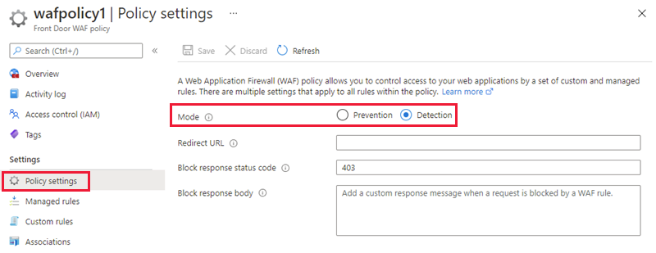
Web Application Firewall policy modes
by default, the WAF policy is in Detection mode
In Detection mode, WAF does not block any requests; instead, requests matching the WAF rules are logged at WAF logs
you can change the mode settings from Detection to Prevention
In Prevention mode, requests that match rules that are defined in Default Rule Set (DRS) are blocked and logged at WAF logs
Notes:
When you create a Web Application Firewall (WAF) policy, by default the WAF policy is in Detection mode. In Detection mode, WAF does not block any requests; instead, requests matching the WAF rules are logged at WAF logs. To see WAF in action, you can change the mode settings from Detection to Prevention. In Prevention mode, requests that match rules that are defined in Default Rule Set (DRS) are blocked and logged at WAF logs.

Slide 60
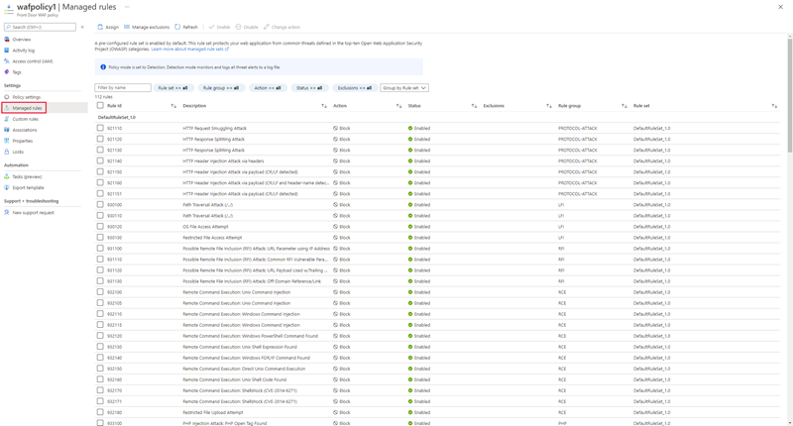
Web Application Firewall Default Rule Set rule groups and rules
Azure-managed Default Rule Set includes rules against the following threat categories:
• Cross-site scripting
• Java attacks
• Local file inclusion
• PHP injection attacks
• Remote command execution
• Remote file inclusion
• Session fixation
• SQL injection protection
• Protocol attackers
Notes:
Azure Front Door web application firewall (WAF) protects web applications from common vulnerabilities and exploits. Azure-managed rule sets provide an easy way to deploy protection against a common set of security threats. Since such rule sets are managed by Azure, the rules are updated as needed to protect against new attack signatures.
Managed rules
Azure-managed Default Rule Set includes rules against the following threat categories:
Cross-site scripting
Java attacks
Local file inclusion
PHP injection attacks
Remote command execution
Remote file inclusion
Session fixation
SQL injection protection
Protocol attackers

Slide 61
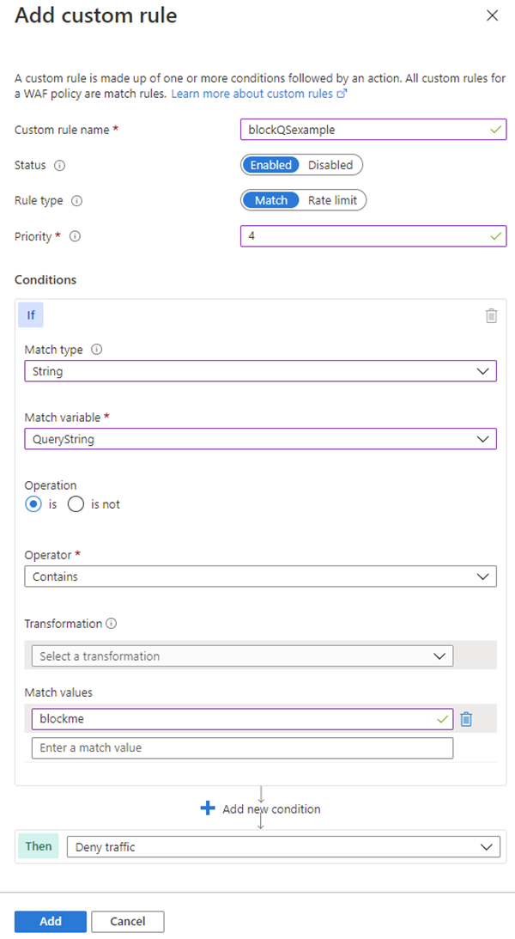
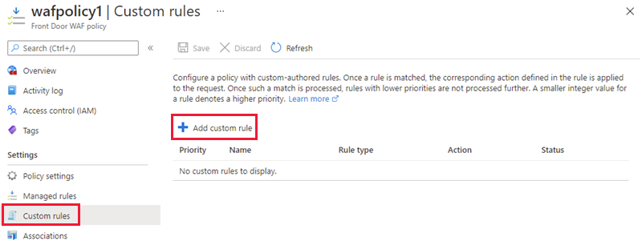
Web Application Firewall Custom Rules
A custom WAF rule consists of a priority number, rule type, match conditions, and an action
There are two types of custom rules: a match rule controls access based on a set of matching conditions
a rate limit rule controls access based on matching conditions and the rates of incoming requests
Notes:
Azure WAF with Front Door allows you to control access to your web applications based on the conditions you define. A custom WAF rule consists of a priority number, rule type, match conditions, and an action. There are two types of custom rules: match rules and rate limit rules. A match rule controls access based on a set of matching conditions while a rate limit rule controls access based on matching conditions and the rates of incoming requests. You may disable a custom rule to prevent it from being evaluated, but still keep the configuration.
When creating a WAF policy, you can create a custom rule by selecting Add custom rule under the Custom rules section. This launches the custom rule configuration page.
The example screenshot below shows the configuration of a custom rule to block a request if the query string contains blockme.

Slide 62
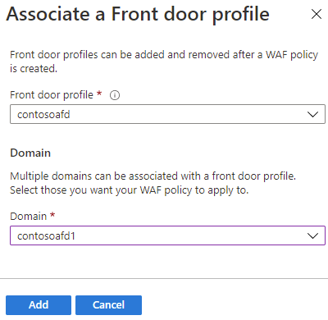
Create a Web Application Firewall policy on Azure Front Door
Create a Web Application Firewall policy - this is where you create a basic WAF policy with managed Default Rule Set (DRS).
Associate the WAF policy with a Front Door profile - this is where you associate the WAF policy created in stage 1 with a Front Door profile. This association can be done during the creation of the WAF policy, or it can be done on a previously created WAF policy. During the association you specify the Front Door profile and the domain/s within the Front Door profile you want the WAF policy to be applied to.
Configure WAF policy settings and rules - this is an optional stage, where you can configure policy settings such as the Mode (Prevention or Detection) and configure managed rules and custom rules.
Notes:
how to create a basic Azure Web Application Firewall (WAF) policy and apply it to a profile in Azure Front Door.
The key stages to create a WAF policy on Azure Front Door using the Azure portal are:
Create a Web Application Firewall policy - this is where you create a basic WAF policy with managed Default Rule Set (DRS).
Associate the WAF policy with a Front Door profile - this is where you associate the WAF policy created in stage 1 with a Front Door profile. This association can be done during the creation of the WAF policy, or it can be done on a previously created WAF policy. During the association you specify the Front Door profile and the domain/s within the Front Door profile you want the WAF policy to be applied to.
During this stage if the domain is associated to a WAF policy, it is shown as grayed out. You must first remove the domain from the associated policy, and then re-associate the domain to a new WAF policy.
Configure WAF policy settings and rules - this is an optional stage, where you can configure policy settings such as the Mode (Prevention or Detection) and configure managed rules and custom rules.
To view the detailed steps for all these tasks, see Tutorial: Create a Web Application Firewall policy on Azure Front Door using the Azure portal

Slide 63
Implement a Web Application Firewall on Azure Front Door - Review
Knowledge Check
Microsoft Learn Modules (docs.microsoft.com/Learn)
What is Azure web application firewall on Azure Front Door? | Microsoft Docs
Azure Web Application Firewall on Azure Front Door Service - frequently asked questions | Microsoft Docs
Notes:
Learn - https://docs.microsoft.com/en-us/learn/browse/

Slide 64
End of presentation

